Slide 1
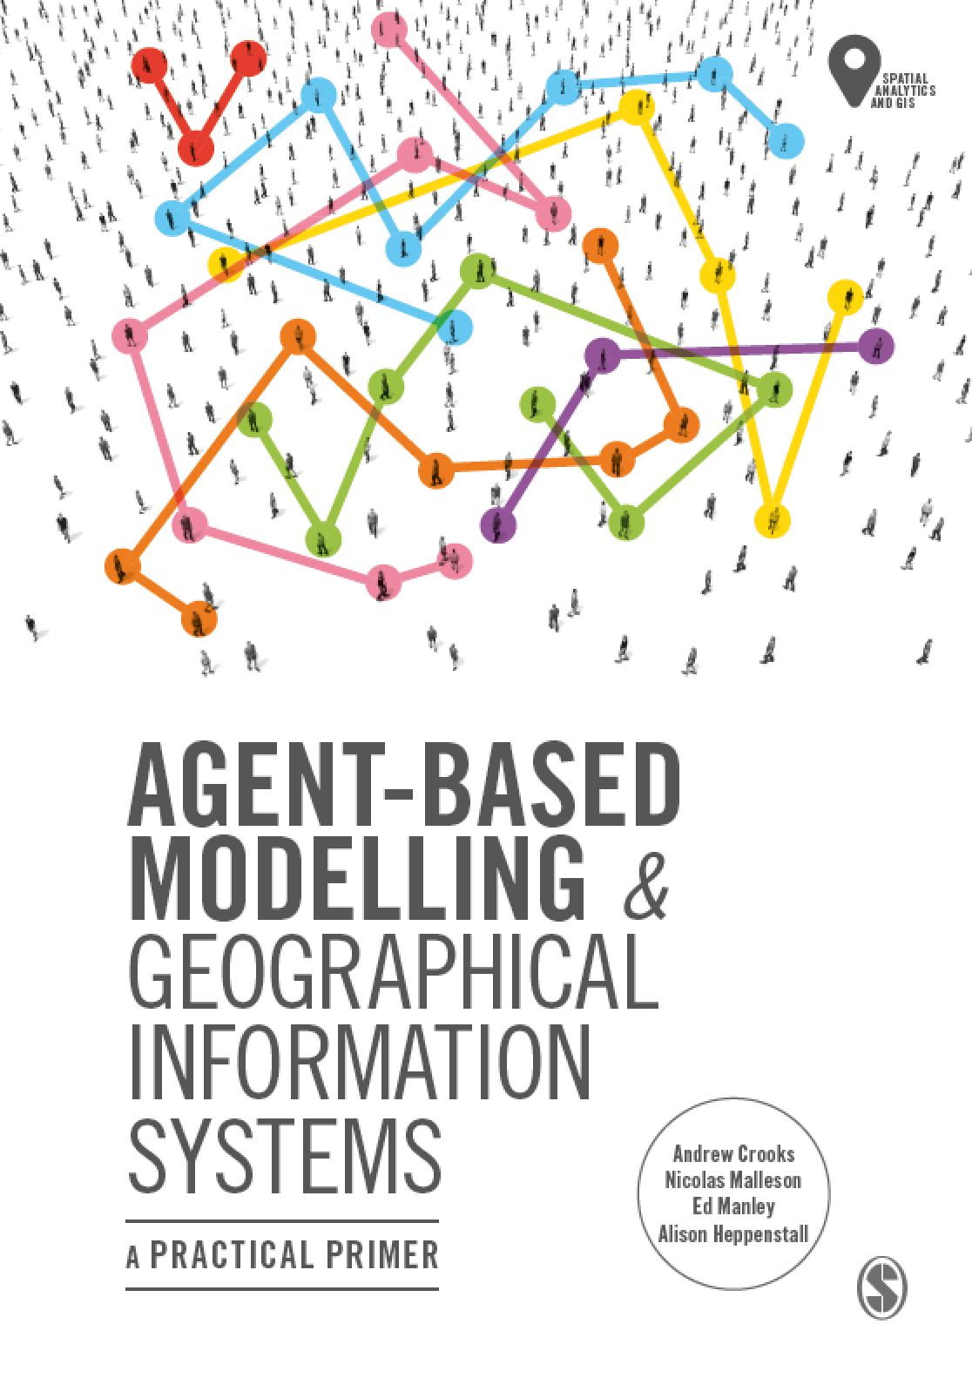
Chapter 6
Integrating Agent-Based Modelling and GIS
Notes:
Building on previous chapters outlining the fundamentals of GIS and agent-based modelling, what are the benefits to linking these approaches? How is this undertaken? This chapter will explain loose and tight coupling critiquing the relative advantages and disadvantages of both. We present an overview of open source toolkits that can be used for the creation of geographically explicit agent-based models before providing a critical look at where and how GIS and ABM should be combined offering practical advice on best practice.

Slide 2
Learning Objectives
By the end of this chapter, students will be able to:

Slide 3
Introduction

Slide 4
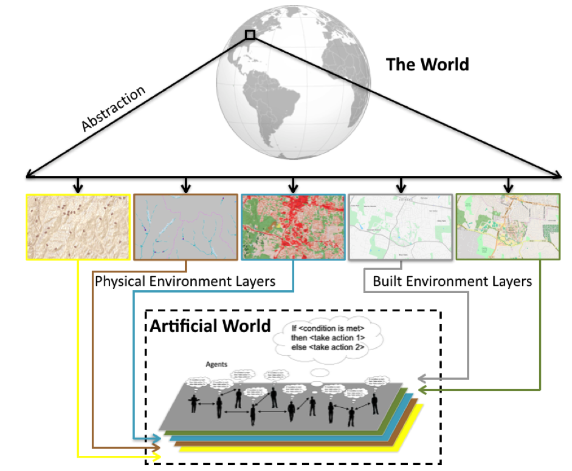
Creating an ‘Artificial World’ from GIS Data
Figure 6.1: Abstracting from the “real” world into a series of layers to be used in the artificial world for which to base the agent-based model upon.

Slide 5
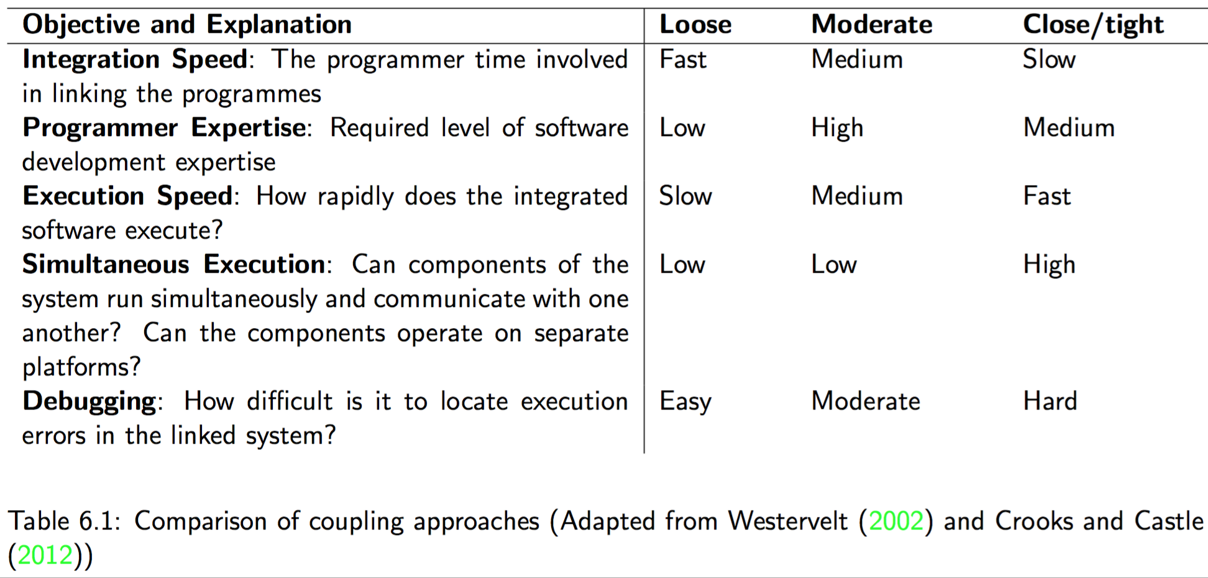
Coupling and Embedding GIS and Agent-based Models

Slide 6
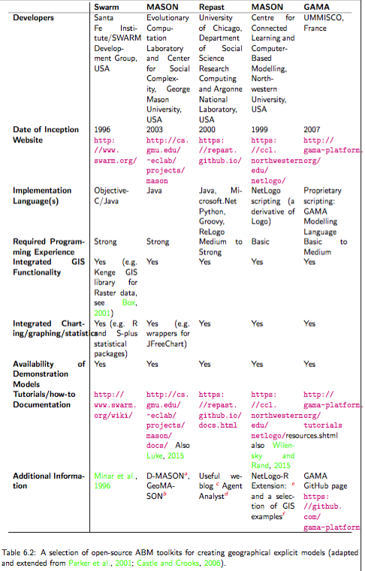
Tools for Constructing and Developing Agent-based Models

Slide 7
Swarm

Slide 8
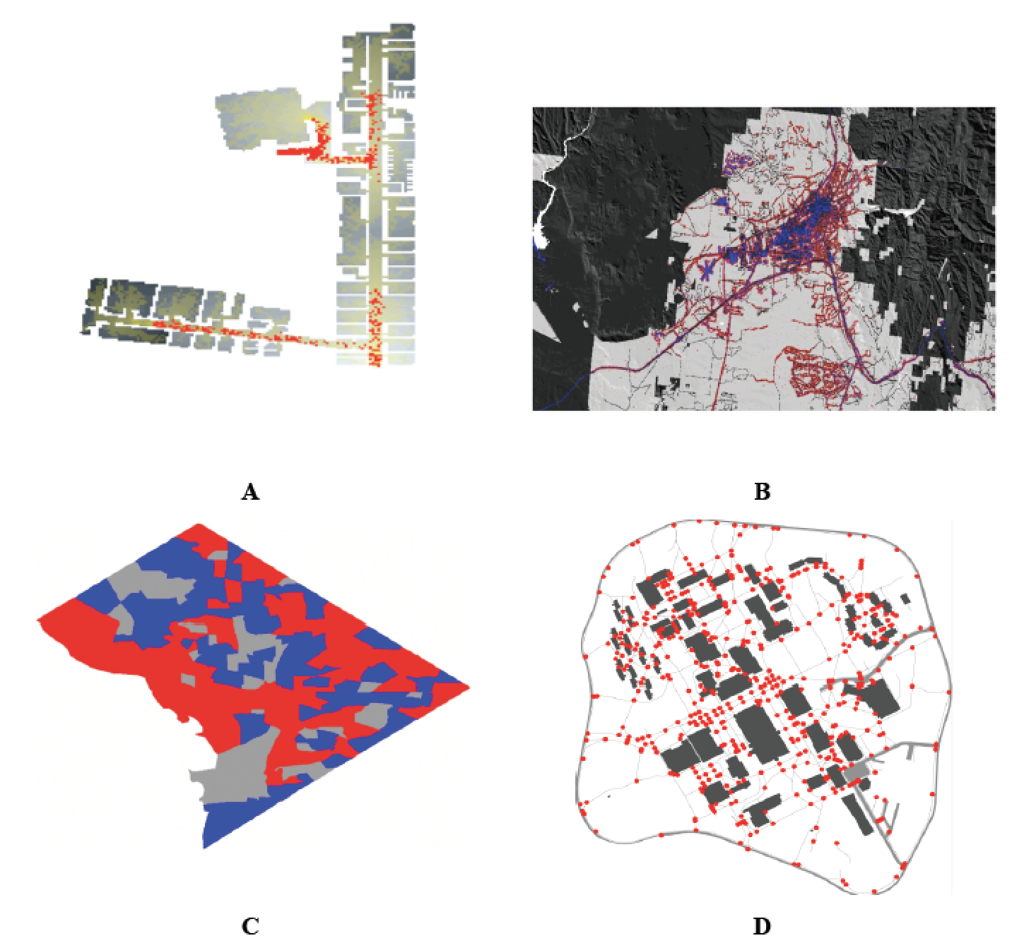
MASON
Figure 6.2: A selection of MASON spatial models (A): Agents (red) exiting a building based on raster data and the resulting trails (yellow). (B) An urban growth model where red areas represent new developments. (C) A Schelling type of model using census areas in Washington DC as its spatial environment. (D) Agents (red circles) moving along on sidewalks (grey lines).

Slide 9
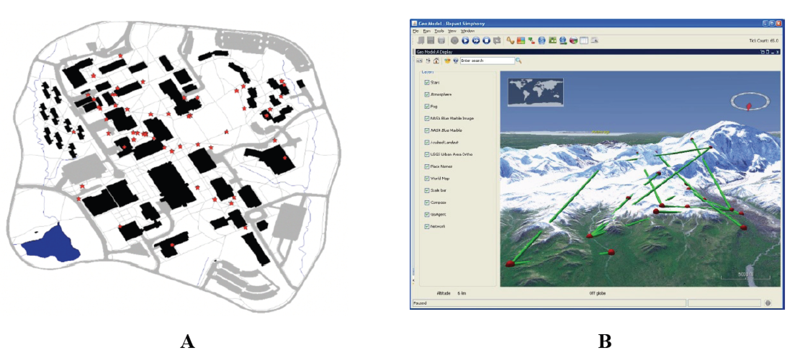
Repast
Figure 6.3: Examples of vector agent-based models in Simphony. (A) Agents (red stars) moving along on sidewalks (grey Lines). (B) An agent-based model overlaid on NASA world wind (Source: Repast, 2016)

Slide 10
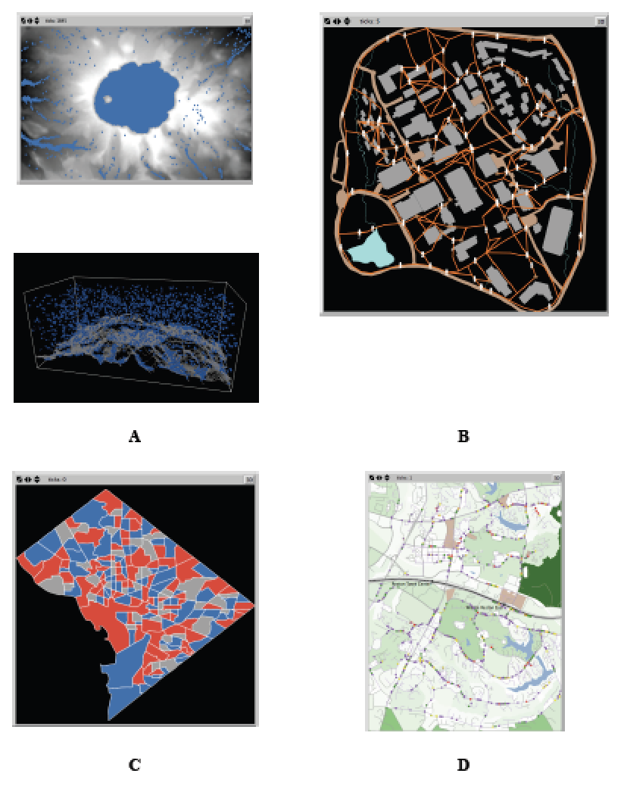
NetLogo
Figure 6.4: A selection of geographically explicit agent-based models utilising NetLogo. (A) Rainfall where rain (blue) falls and flows to a lower elevation based on a digital elevation model captured in 2 and 3D. (B) Agents (white) moving along on sidewalks (orange). (C) Schelling type model using census areas in Washington DC as their spatial environment. (D) Commuting along a road network.

Slide 11
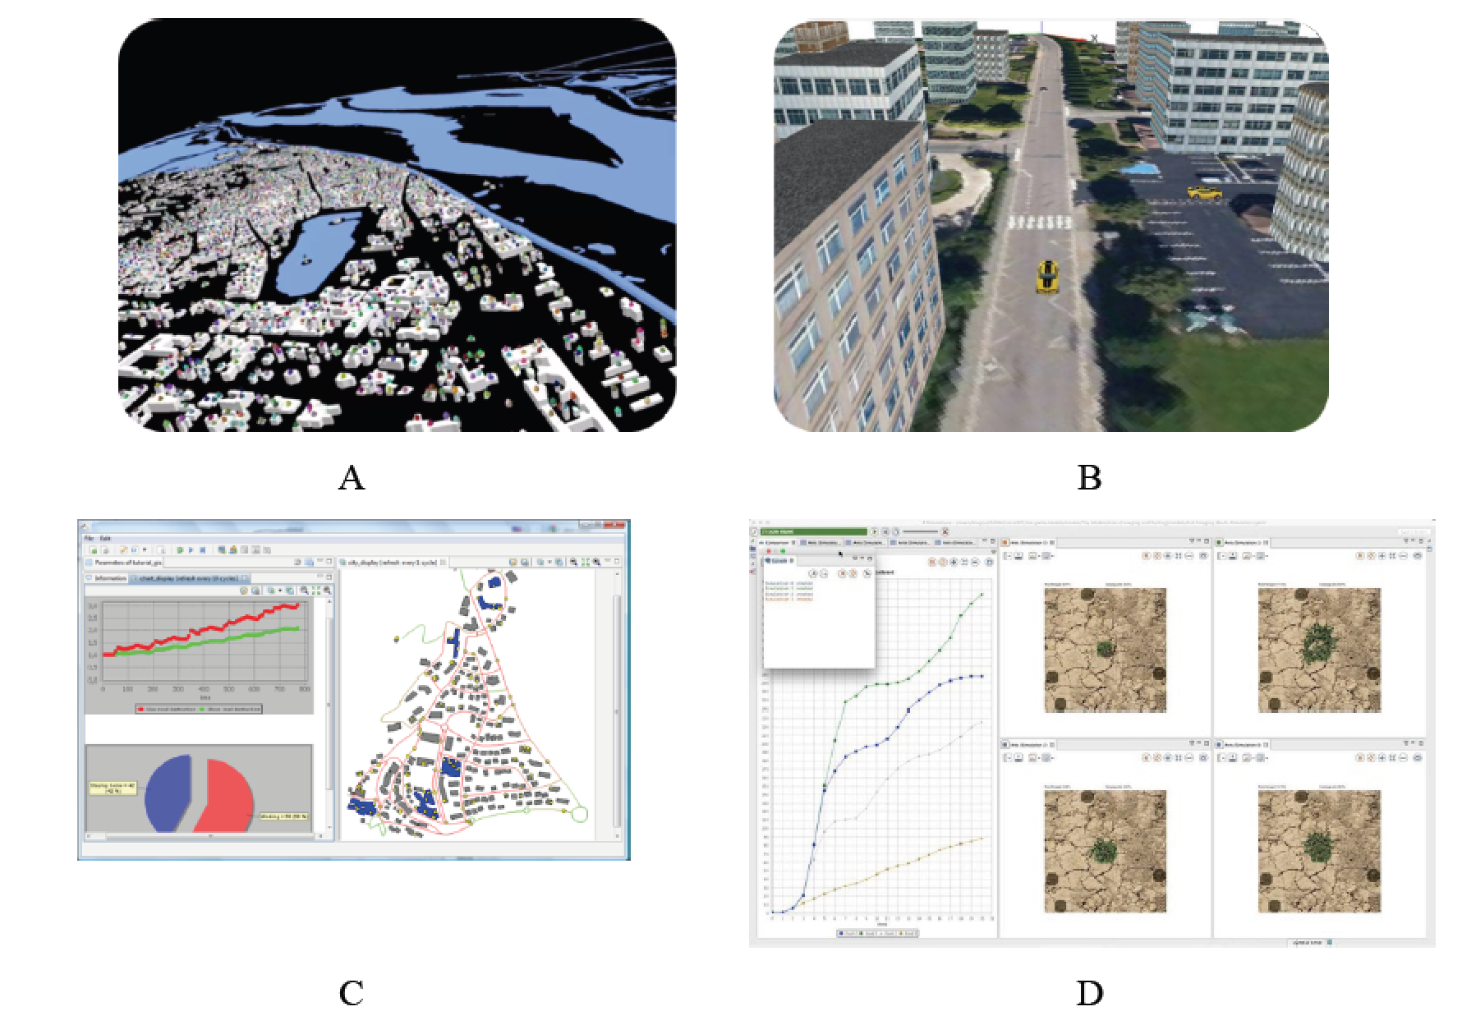
GAMA
Figure 6.5: GAMA platform: Advanced visualisation of simulations (A and B). (C) Built in charting and functions. (D) User interface (Source: GAMA, 2016).

Slide 12
Using Raster Data in NetLogo

Slide 13
Raster Model Examples: Urban Growth and Pedestrian Modelling

Slide 14
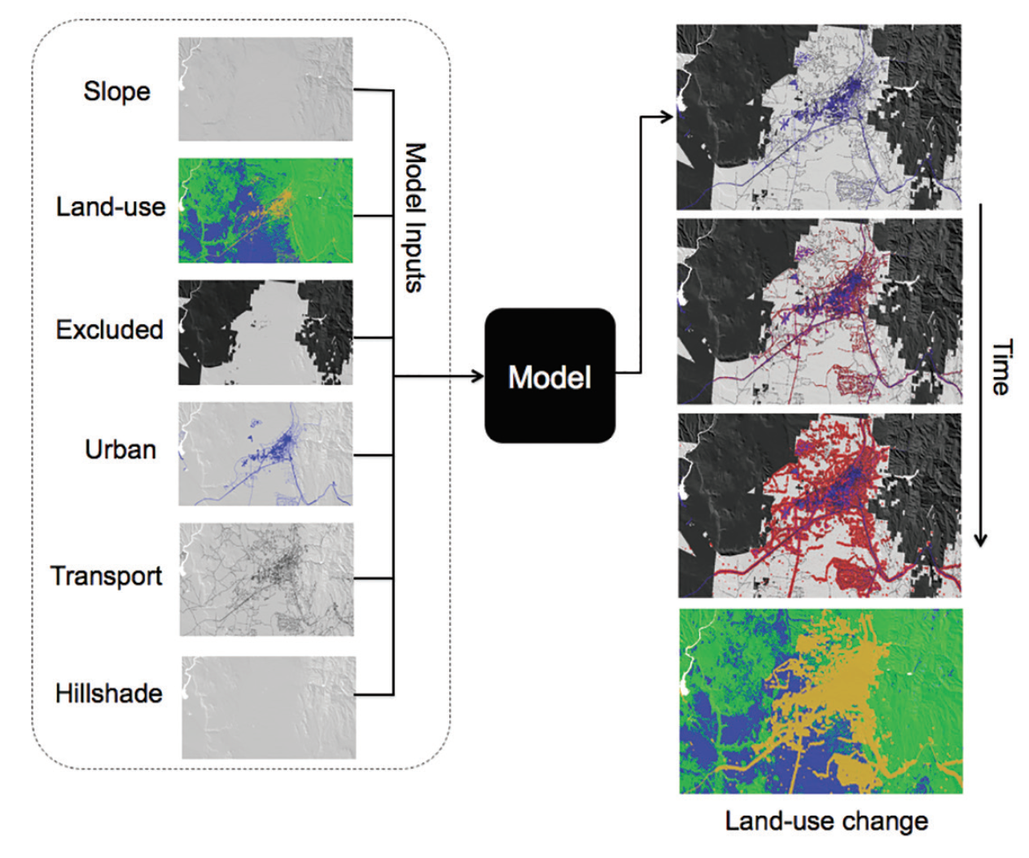
A SLEUTH-Type Model
Based on growth rules and coefficients as outlined in Clarke et al. (1997). In this example, the model is simulating the rates of land-use change
in Santa Fe, New Mexico.
Clarke, K. C., S. Hoppen, and L. J. Gaydos (1997). A Self-Modifying Cellular Automaton Model of Historical Urbanization in the San Francisco Bay Area. Environment and Planning B 24(2), 247{261.

Slide 15
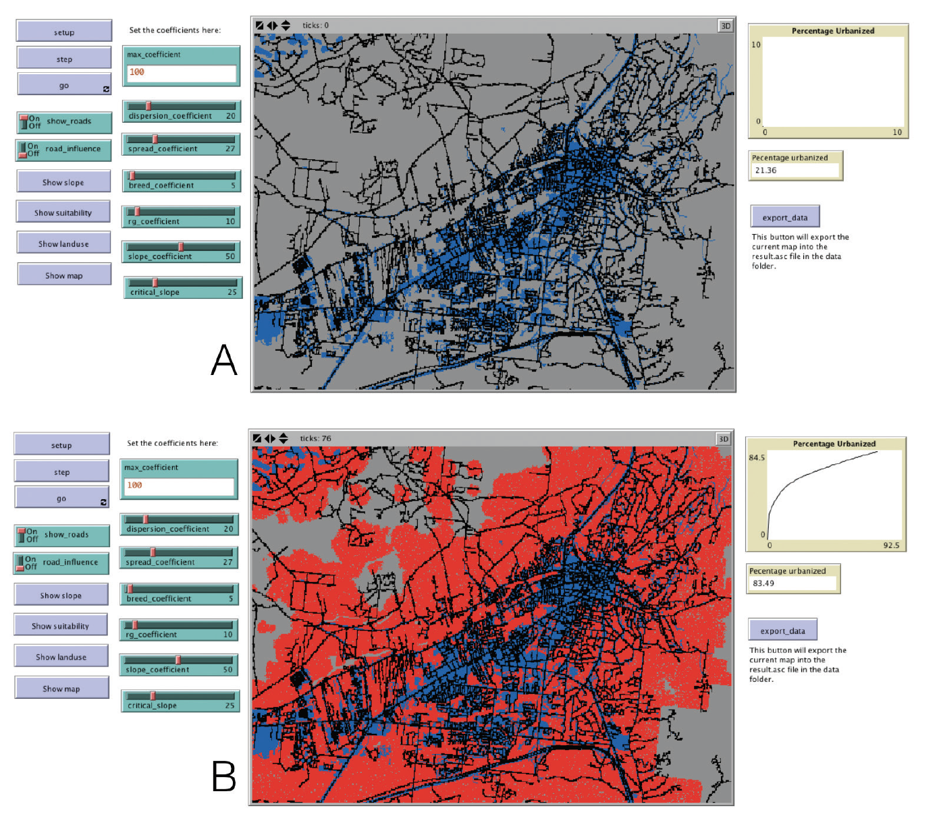
A Basic SLEUTH-Type Model
Model based on growth rules and coefficients driving the rates of land-use change stylized on Santa Fe, New Mexico implemented in NetLogo:
(A) initial conditions (blue cells);
(B) urban growth (red cells).
Click here to download the model

Slide 16
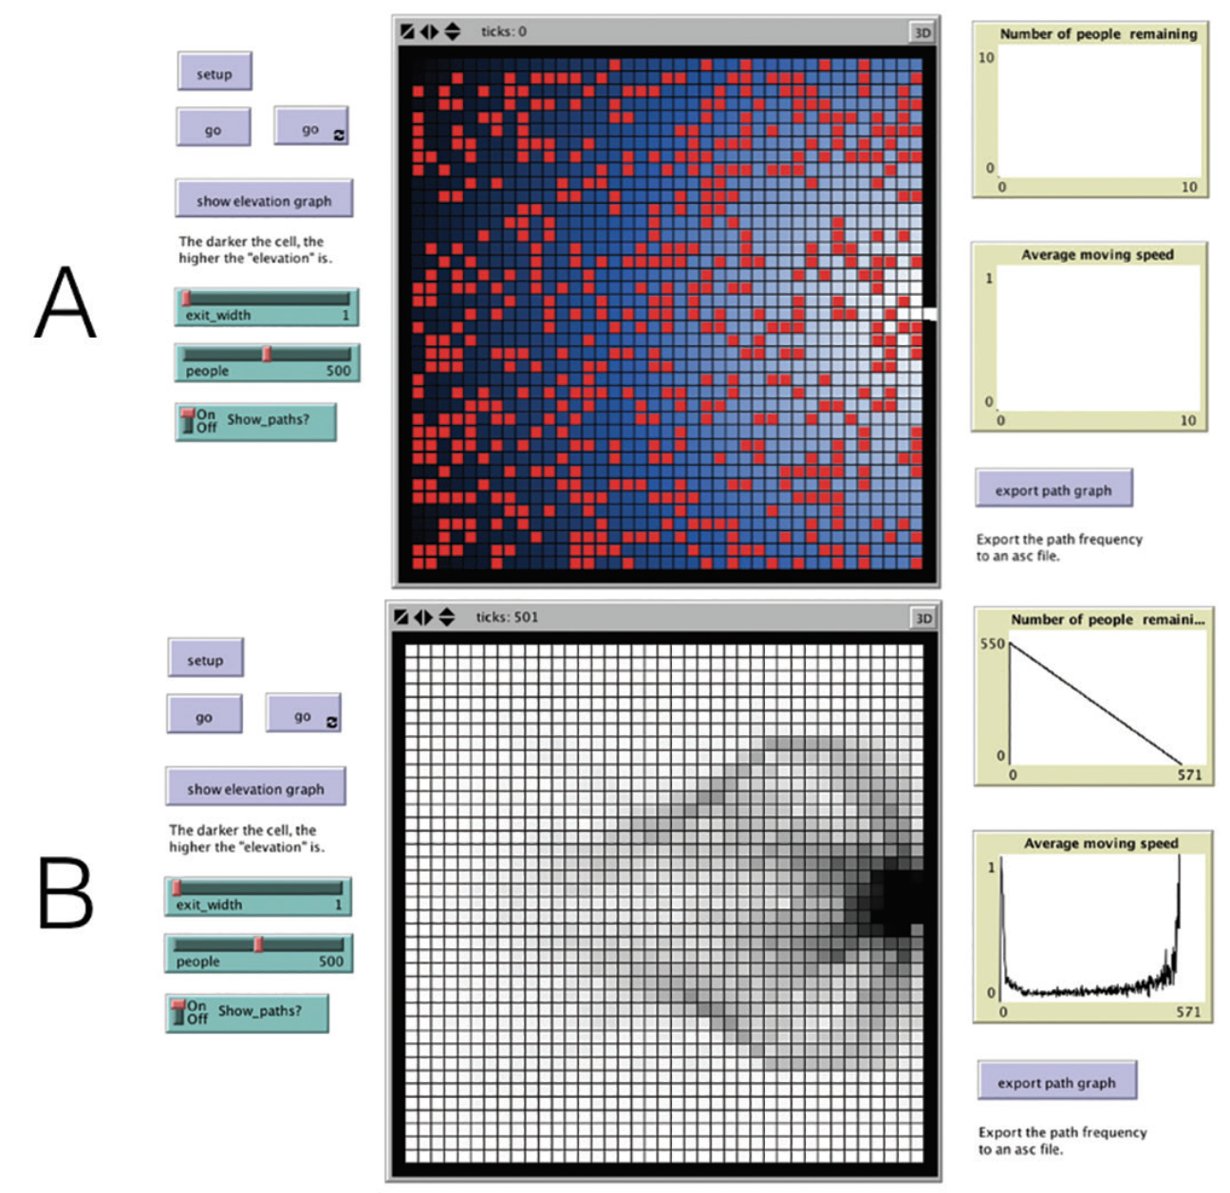
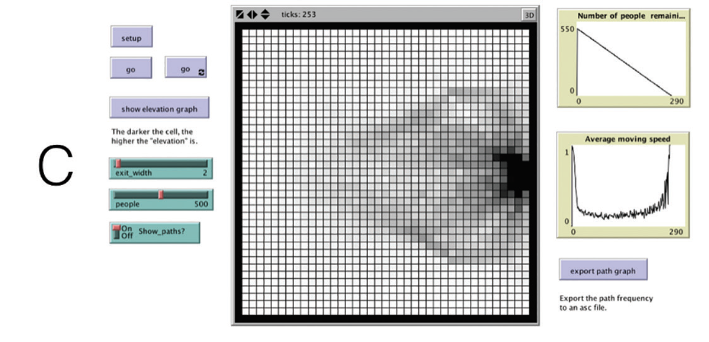
A Simple Pedestrian Evacuation Model where Agents are Exiting a Room
(A) initial starting conditions where the red dots represent agents and the blue represent a cost surface;
(B) pedestrian paths when the door is one cell wide,
(C) pedestrian paths when the door is two cells wide
Click here to download the model
Notes:
A simple pedestrian evacuation model where agents are exiting a room:
(A) initial starting conditions where the red dots represent agents and the blue represent a
cost surface;
(B) pedestrian paths when the door is one cell wide,
(C) pedestrian paths when the door is two cells wide

Slide 17
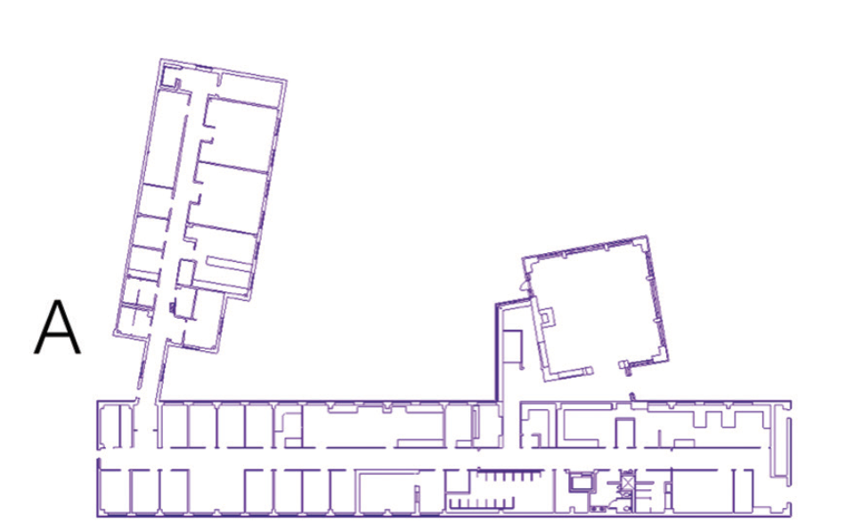
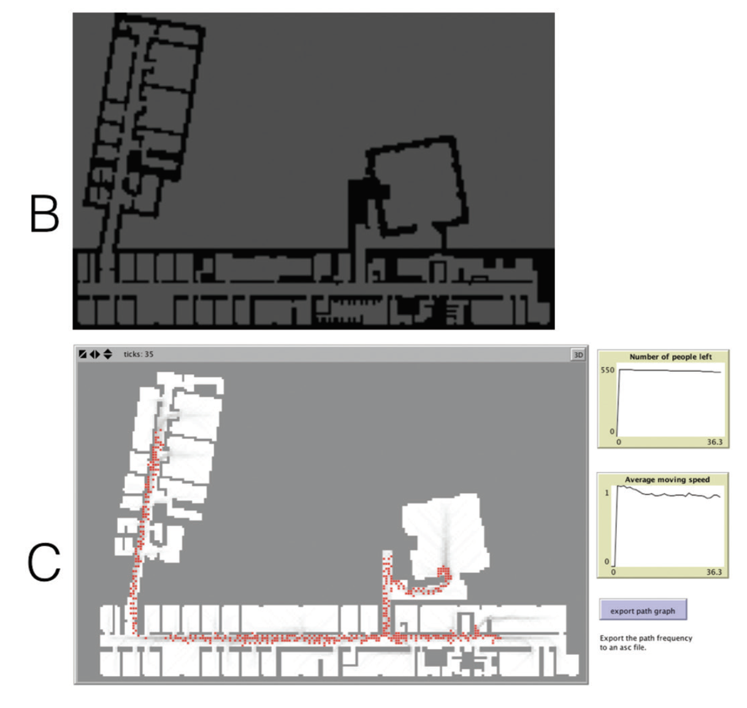
Pedestrian Modelling
Click here to download the model
CAD floor plans of a building (A) are converted into a raster layer (B) and are used as the environment for the agent-based model; (C) shows the simulation running with agents (red) who are exiting the building and leaving behind walking traces (grey)
Notes:
Simple pedestrian model: CAD floor plans of a building (A) are converted into a raster layer (B) and are used as the environment for the agent-based model; (C) shows the simulation running with agents (red) who are exiting the building and leaving behind walking traces (grey)

Slide 18
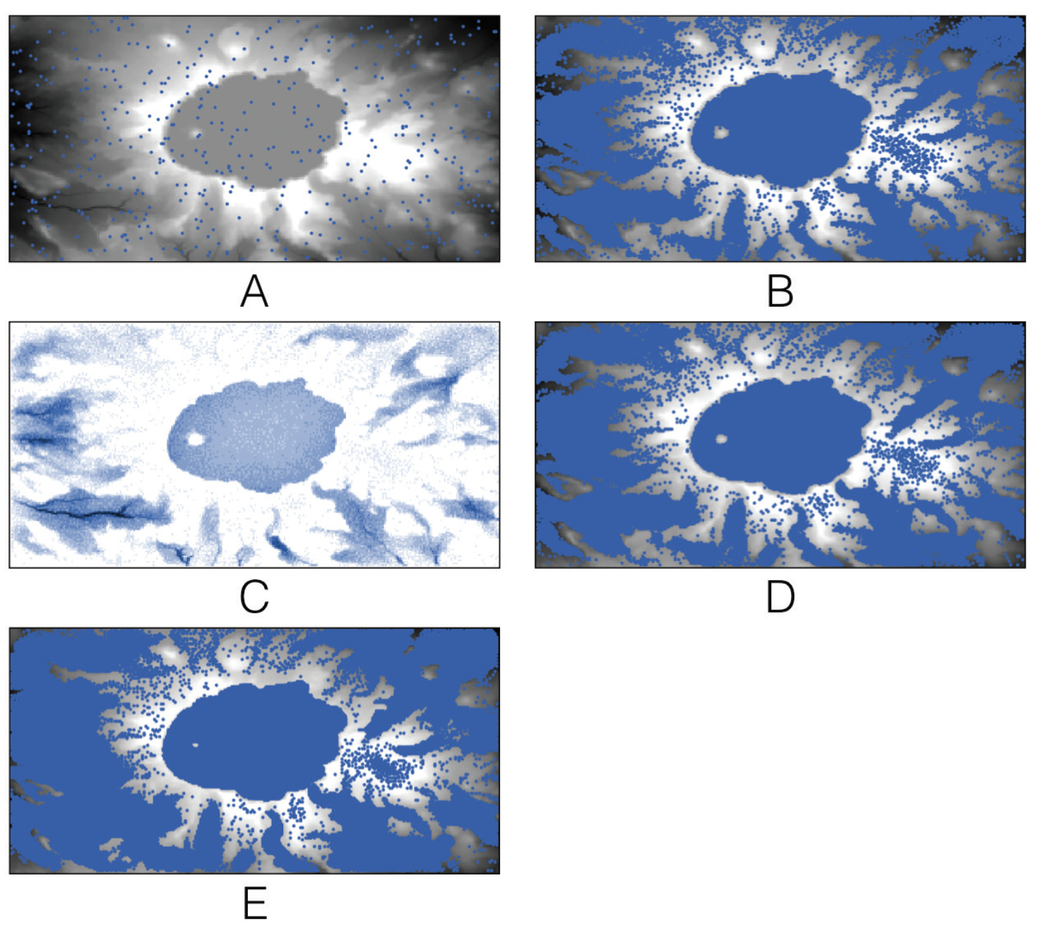
A simple hydrological model in which rain falls from the sky and flows downhill
(A) initial starting conditions where the blue dots represent agents (i.e. water) and the underlying digital elevation model;
(B) over time rain accumulates in Crater Lake;
(C) water depth at time step 500 and
(D) the corresponding water;
(E) Crater Lake has enough water for it to discharge.
Click here to download the model

Slide 19
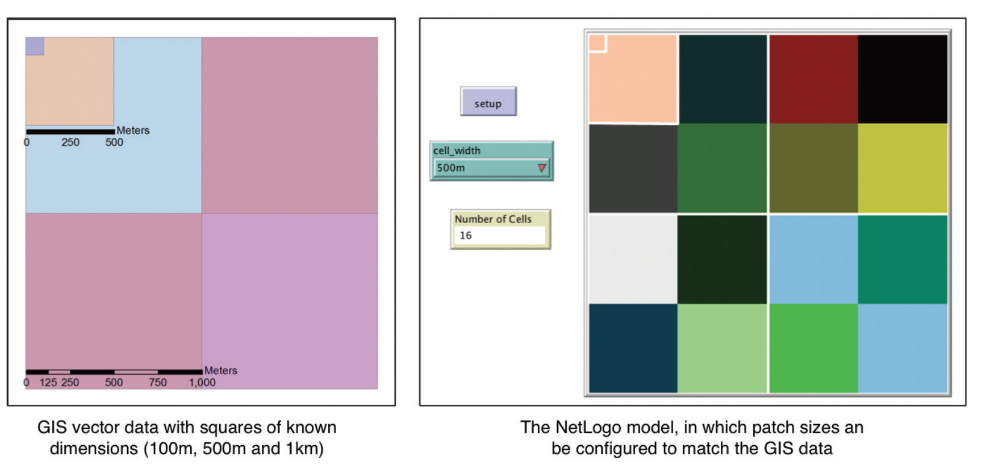
Setting the NetLogo patch size so that it corresponds with some vector GIS data
Click here to see the Model

Slide 20
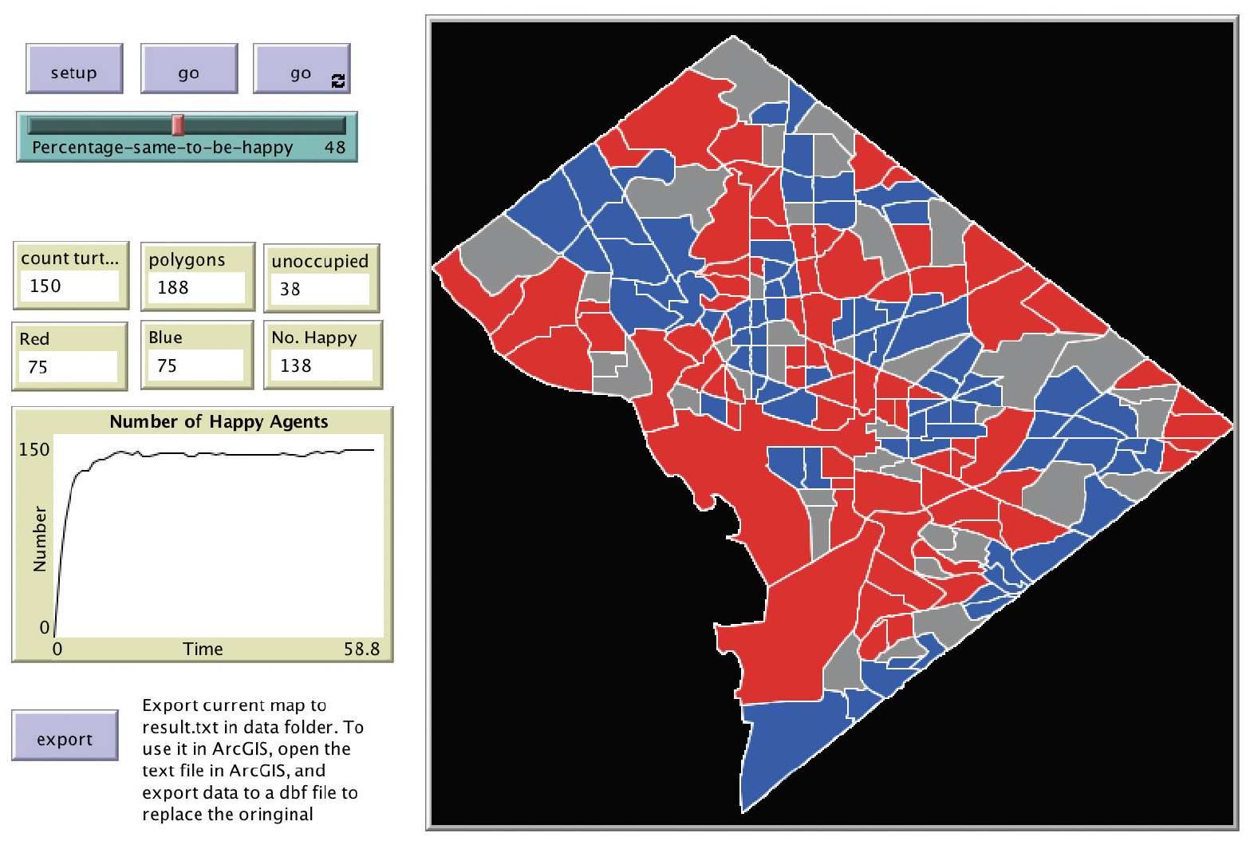
The Schelling segregation model implemented using polygon as agents
Click here for the model

Slide 21
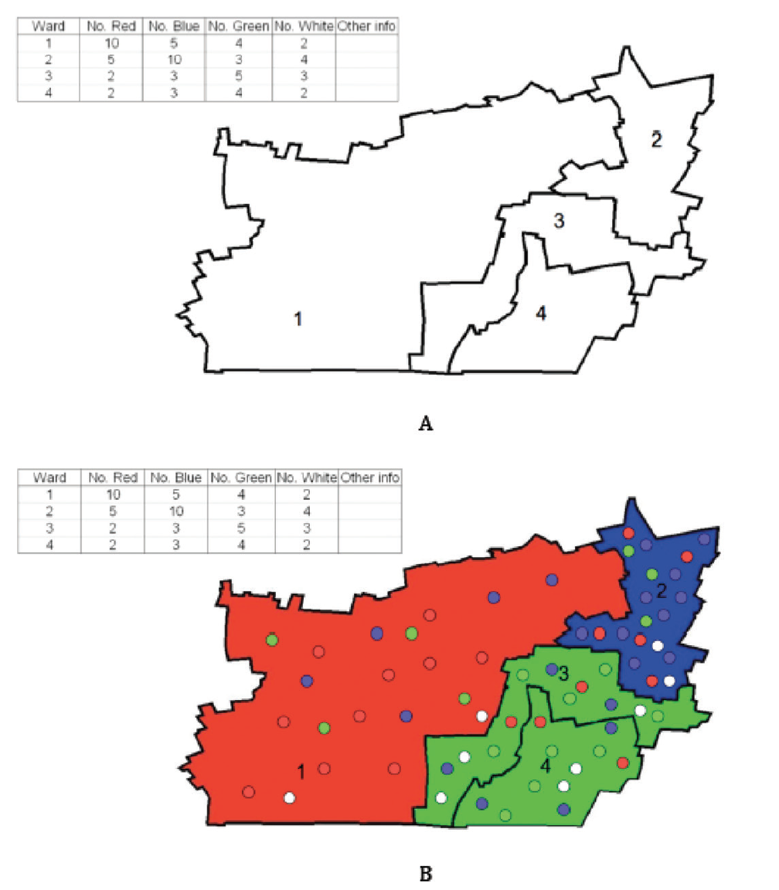
Reading in a shapefile and creating agents

Slide 22
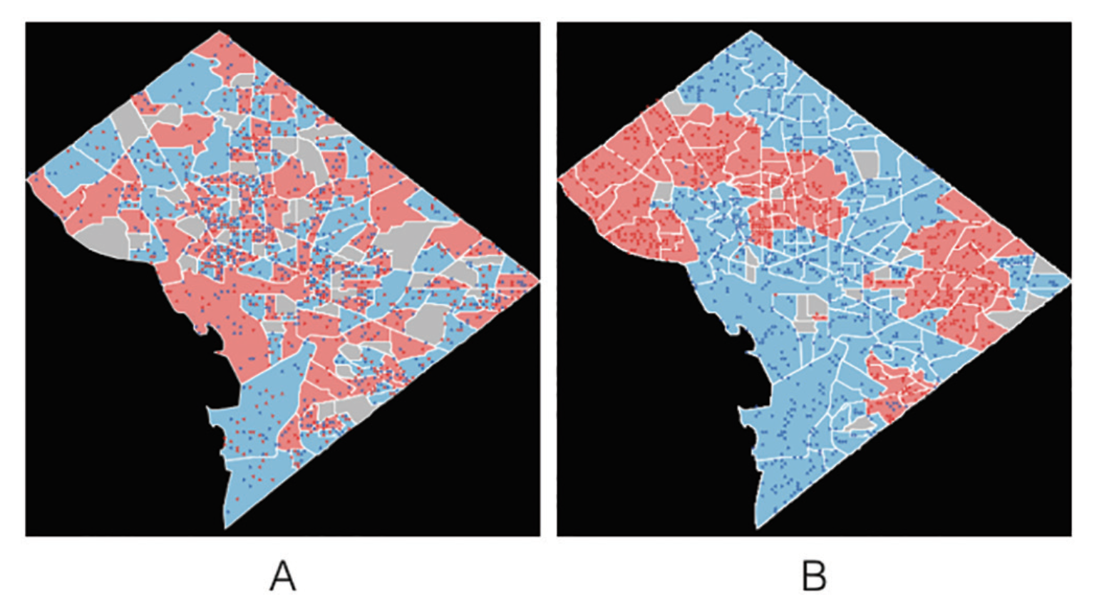
(A) Instantiation of a segregation model where each agent is created from attribute information and (B) the resulting end state when all agents are satisfied with their neighborhood.
Click here for the model
Notes:
(A) Instantiation of a segregation model where each agent is created from attribute information and (B) the resulting end state when all agents are satisfied with their neighbourhood.

Slide 23
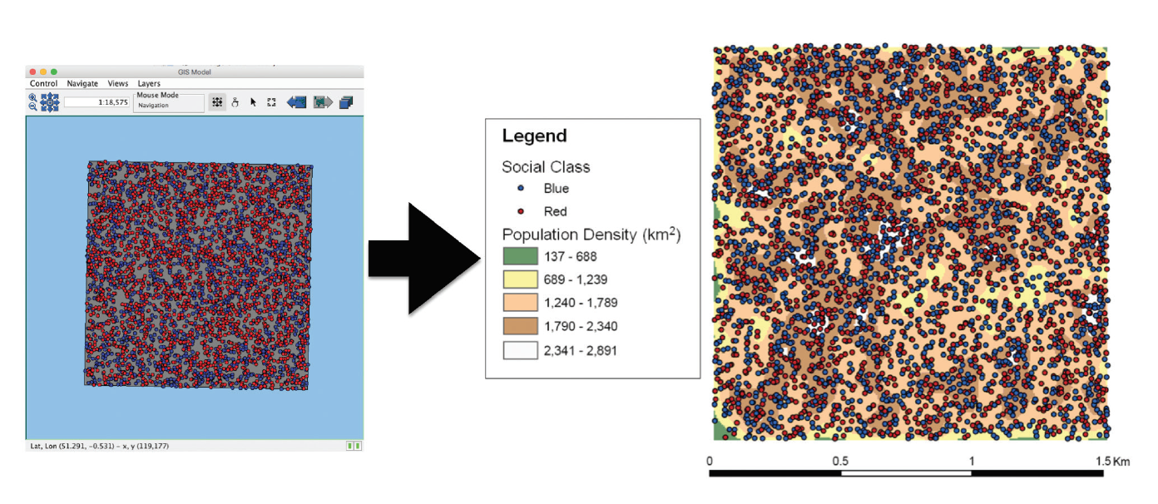
An example of taking attribute data from a model and then exploring it in a GIS.
Here, agents are exported from a RepastJ model of segregation as a point shapefile. Their locations are then used to calculate the population density using ArcGIS

Slide 24
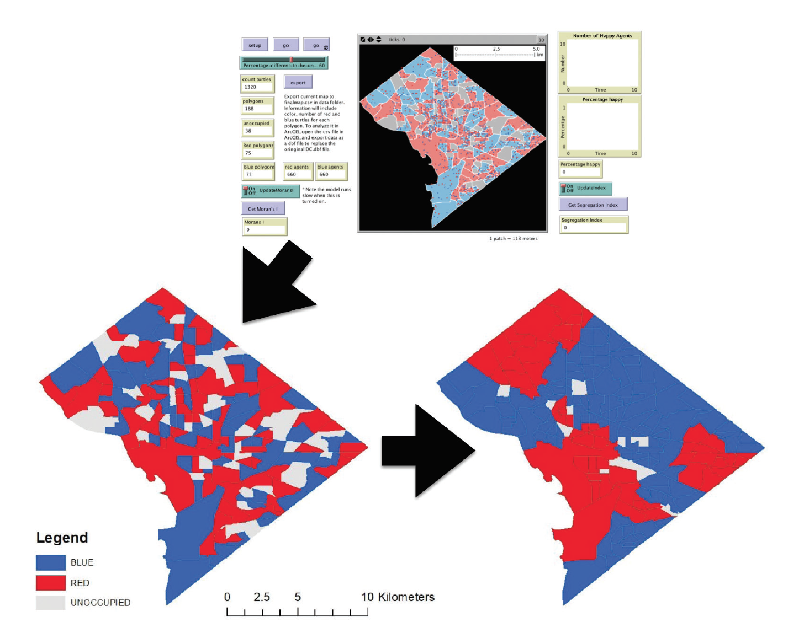
Segregation Model
An example of taking attribute data from the NetLogo Schelling model and displaying it in a GIS.
Agents are exported from the Schelling model as a .txt file at the start and end of the simulation.
They are displayed in a GIS. Initially there are 1320 agents distributed over 118 polygons (of which 75 are blue, 75 are red, 38 are unoccupied).
Each agent has a preference to be in an area where 60% of their neighbors are of the same color.
Over the course of the simulation this results in agents moving and altering the population and colors of the polygons (114 blue, 58 red, 16 unoccupied).

Slide 25
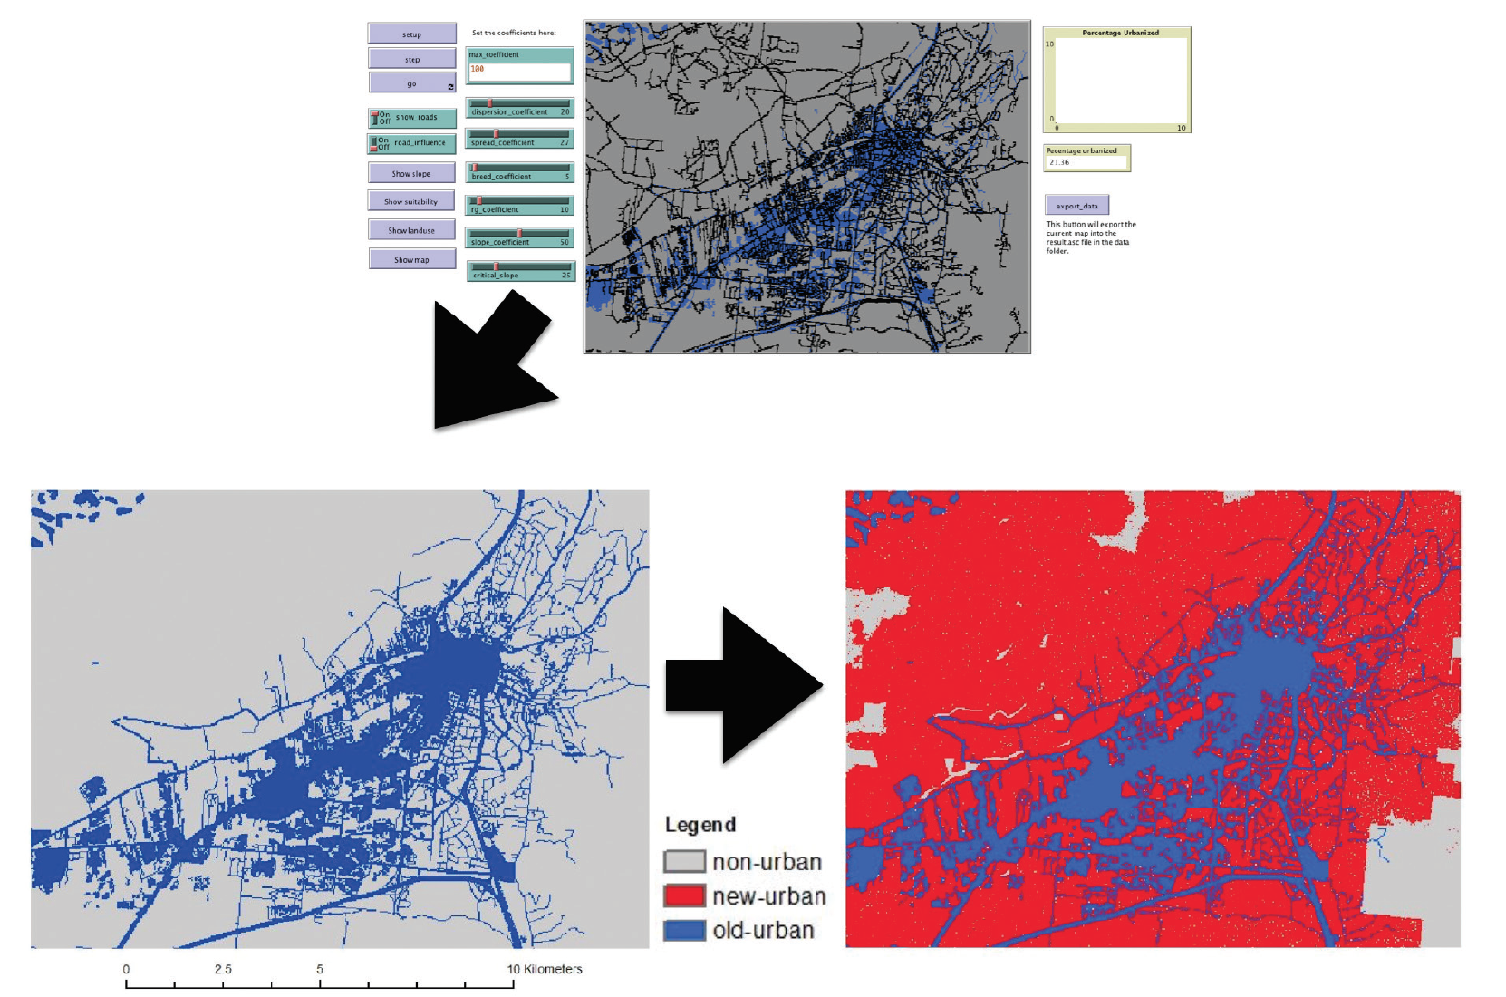
Urban Growth
Exporting raster data from a simple urban growth NetLogo model and visualizing it in a GIS for further analysis. In this example the model ran for 100 time steps and the area urbanized went from 21% to 92%
See Urban Growth Model
Notes:
Exporting raster data from a simple urban growth NetLogo model and visualising it in a GIS for further analysis. In this example the model ran for 100 time steps and the area urbanised went from 21% to 92%

Slide 26
Discussion
Notes:
This chapter has highlighted the ability to import and export geospatial data in
both raster and vector formats (via a loose coupling approach). Both types of
formats have their advantages and disadvantages. For cellular space, it is much
easier conceptually and computationally as one can use Moore and von Neumann
neighbourhoods. Furthermore, a vast amount of data comes in raster formats, such
as remote sensing data. However, using cellular space, there is no way of representing
complex geometries. The advantages of using vector space include the ability
to give more realism to models by allowing the representation of any geographical
shape, moving away from treating the world as a series of square objects. Also, most
demographic data comes in this format, thus the data does not have to be transformed
to a series of cells. However, these advantages come at a price. Topological
calculations (such as neighbourhood calculations, the distance between two points, and point-in-polygon operations) are expensive in terms of execution speed, thus
limiting the performance of a vector-based model. Therefore, which space to use
for geospatial models depends on the purpose of the model. Benenson et al. (2005)
comment that while vector GIS can represent urban objects in spatially explicit
models, for theoretical models the points of a regular grid will usually suffice.
By adding real-world geographical information to agent-based models we now
not only have the ability to model actual decision-making units such as individuals,
households and firms but also can account for the influence of specific local
conditions. Moreover, we can use data from GIS to create artificial populations and
agent descriptions based on data about the area under investigation. Not only does
this allow us to set the initial conditions of the model, for example, land use or the
predominant social class of the area, but if time series data is available (e.g. census
or house price data) we could compare population shifts or housing dynamics to
actual places.

Slide 27
Summary
Notes:
In previous chapters we have shown how agent-based modelling allows us to
explore how individuals interact, giving rise to the emergence of aggregate patterns
(e.g. crowds or segregation). This environment can be used as an artificial
laboratory to test out ideas and hypotheses. In this chapter we have demonstrated
how GIS allows us to create agent-based models that are directly related to actual
geographical locations via raster and vector data sets. It was also demonstrated
how GIS data can provide a landscape for the agents to inhabit (e.g. a terrain for
them to walk upon, or locations to live) as well as deriving attributes from such
data to instantiate agents. In the following chapters attention will be focused on
how geographical information can be used to compare aggregate outputs from
these models to real-world phenomena.

Slide 28
Further Reading
More information about GIS functionality in NetLogo readers are referred to: https://ccl.northwestern.edu/netlogo/docs/gis.html along with the NetLogo GitHub page: https://github.com/NetLogo/GIS-Extension
While the website Simulating Complexity https://simulatingcomplexity.wordpress.com/2014/08/20/turtles-in-space-integrating-gis-and-netlogo provides a good tutorial on integrating GIS into NetLogo.
Key texts about the integration of GIS and agent-based modelling, readers are referred to:
Crooks, A.T. and Castle, C. (2012), 'The Integration of Agent-Based Modelling and Geographical Information for Geospatial Simulation', in Heppenstall, A., Crooks, A.T., See, L.M. and Batty, M. (eds.), Agent-based Models of Geographical Systems, Springer, New York, NY, pp. 219-252.
Maguire, D.J., Batty, M. and Goodchild M, F. (eds.) (2005), GIS, Spatial Analysis and Modelling, ESRI Press, Redlands, CA.
Westervelt, J.D. (2002), 'Geographic Information Systems and Agent-Based Modelling', in Gimblett, H.R. (ed.) Integrating Geographic Information Systems and Agent-Based Modelling Techniques for Simulating Social and Ecological Processes, Oxford University Press, Oxford, UK, pp. 83-104.

Slide 29
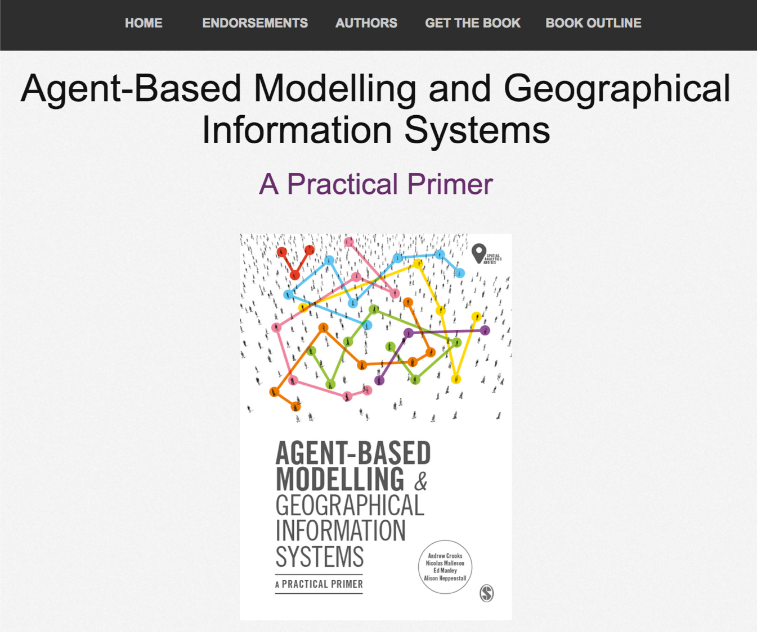
Online Resources
Visit: https://github.com/abmgis/abmgis/tree/master/Chapter06-IntegratingABMandGIS for a selection of models to highlight core concepts introduced in this chapter along with a tutorial.

